Slide 1

ALL SAINTS RESTRUCTURE UPDATE
ASC PARISH TOWN HALL
NOVEMBER 19, 2020

Slide 2
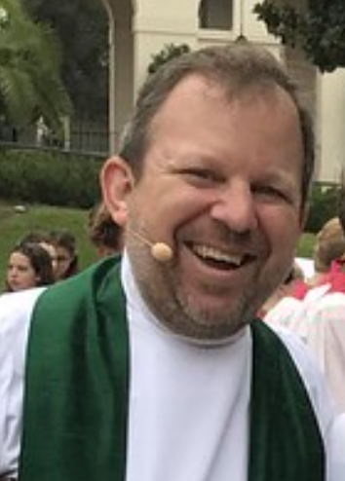
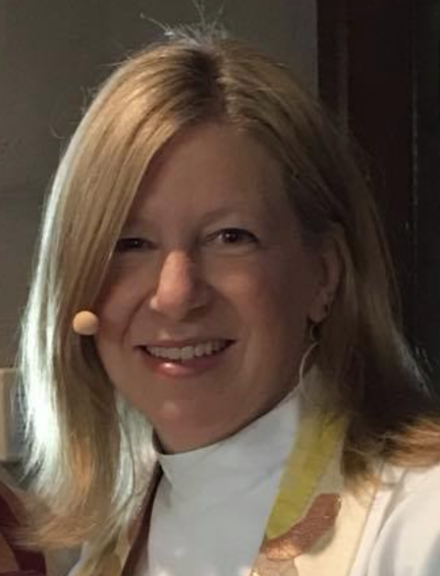
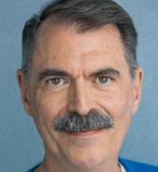
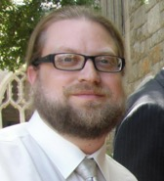
CIRCLES TRANSITION TEAM
Sally Howard, Mike Kinman, Art McDermott, Walter Little
Tasked with determining the logistics of transitioning to the ”circles” model
  Mike brings the organization and theological vision and experience working with this approach at Thistle Farms and other orgs
  Sally brings knowledge/experience in creating healthy systems, and theological perspective grounded in contemporary human development
  Art has experience implementing similar structures in the not-for-profit sector
  Walter has experience with various approaches/attempts to move to this model in the for-profit sector

Slide 3
TRADITIONAL ORGANIZATIONAL STRUCTURE
Top-Down, Hierarchical, Chain-of-Command
Rector
Exec Asst
Assoc. Rector Pastoral Care
Sr Assoc P&J
Dir Communication
Dir Liturgy
Dir Music
Dir Giving
Assoc. Rector Cong. Devel
Parish Administrator
Admin Asst
Assoc Organist
Admin Asst
Sr Assoc CYF
Dir IT
Dir B&G
Comptroller
Admin Asst
Child Minister
Custodian
Accountant
Admin Asst
Assoc Youth Minister
Dir Child/Youth Music

Slide 4





THIS MODEL IS EVOLVING IN THE 21ST CENTURY…
Some corporations and nonprofits have invested in other organizational models to increase organizational effectiveness and competitive advantage
Common features:
  They are flatter – prioritize support, not power
  Overlapping teams or circles of employees
  Collaborative focus
  Shared authority, decision-making power closer to the people doing the work
  Cross-functional teams/pods/circles
  Hierarchies are dynamic and change as work changes

Slide 5
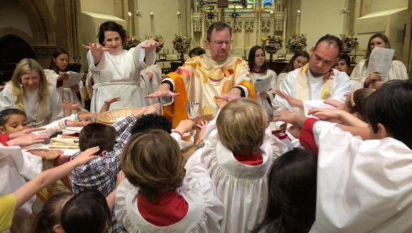
A THEOLOGICAL BASIS
The revolutionary Jesus loves subversively
Everyone at the table together
Power in Christ not an individual
Values at the center
Circles are Christ’s Open Table
Priests lead by gathering, not by dominating

Slide 6
THIS MODEL ISN’T COMPLETELY NEW
ASC has always been collaborative…
…and there has always been a hierarchy with rector at the top and authority distributed based relationship with the rector
This was the best thinking of the day
Previous structures embodied this
We are learning new, more creative ways – and we have already been trying them out – Liturgy Design, Vestry, Warden’s Planning Task Force
We are putting scaffolding in place to make this the permanent basis of our structure

Slide 7
THE STRUCTURE IS ONLY THE BEGINNING
We are taking on a significant cultural shift Structural change is just one part
We will work collaboratively to:
  Address staff culture issues
  Invest in technology
  Define process for allocating financial resources
  Implement methodology for determining priorities
  Foster culture of learning, innovation, creative problem-solving
  Err on the side of gracefulness and forgiveness

Slide 8
THE CIRCLES
Liturgy and Worship
Beloved Community
Progressive Intent Into Action
Learning and Spiritual Growth Across the Lifespan
Administration

Slide 9
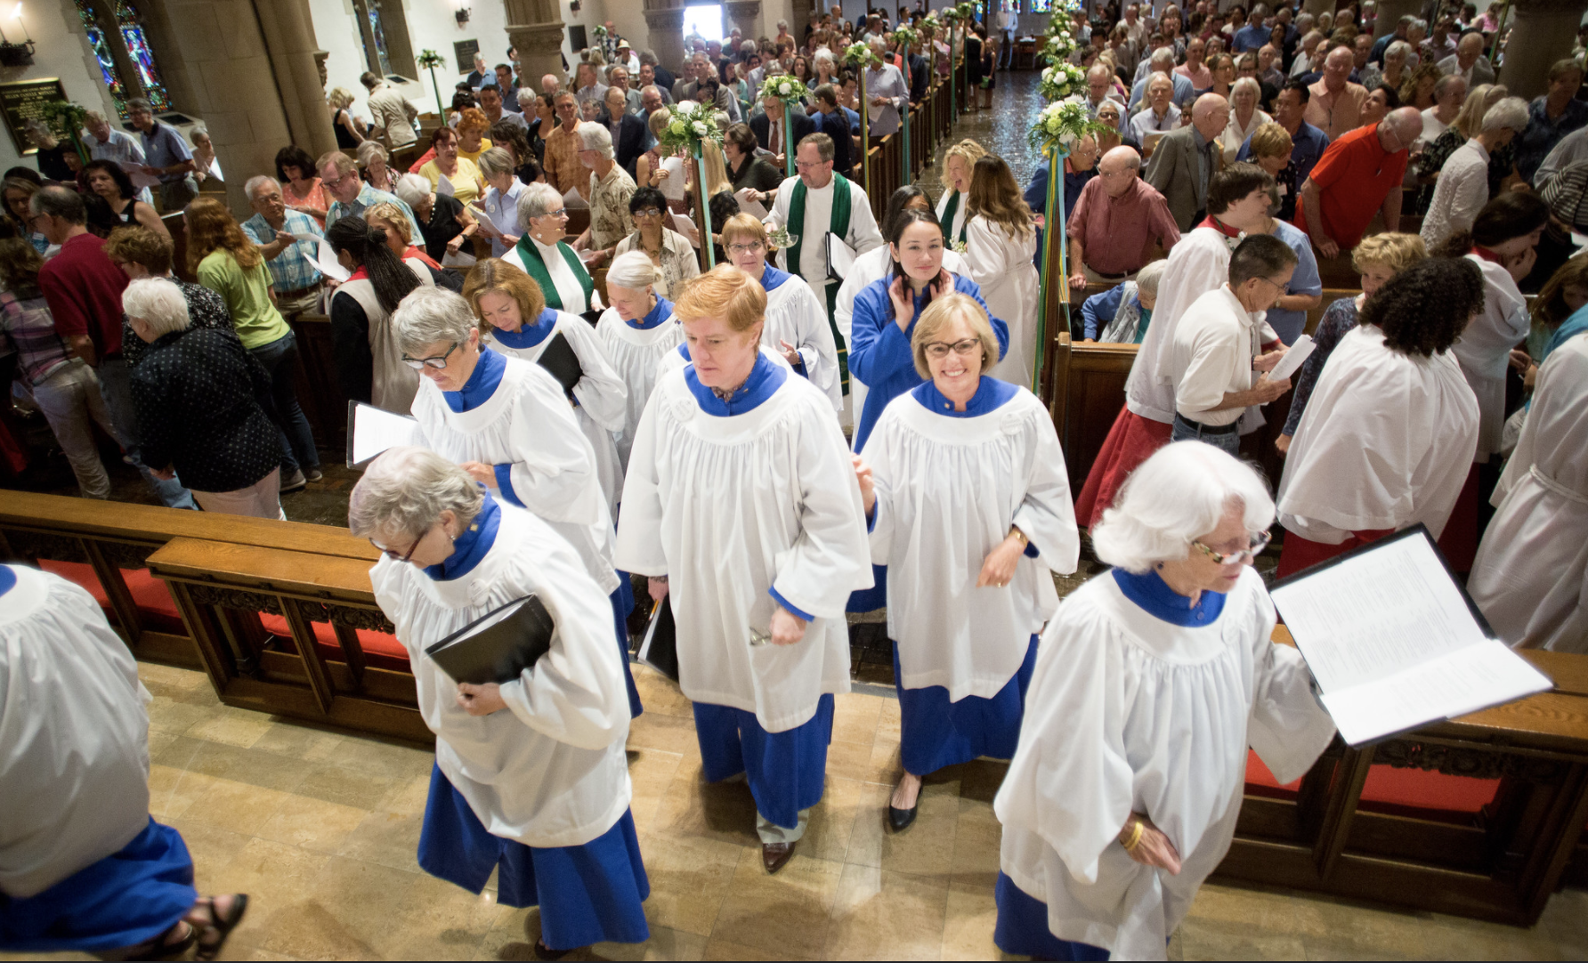
THE CIRCLES – LITURGY AND WORSHIP
Gathers the community in expression of self-offering through liturgical worship

Slide 10
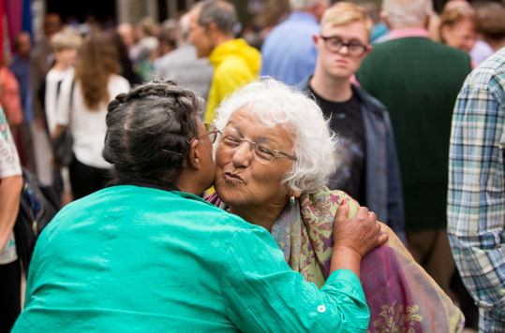
THE CIRCLES – BELOVED COMMUNITY
Establishes, maintains, and grows bonds of loving relationship among all who come into the orbit of All Saints Church

Slide 11
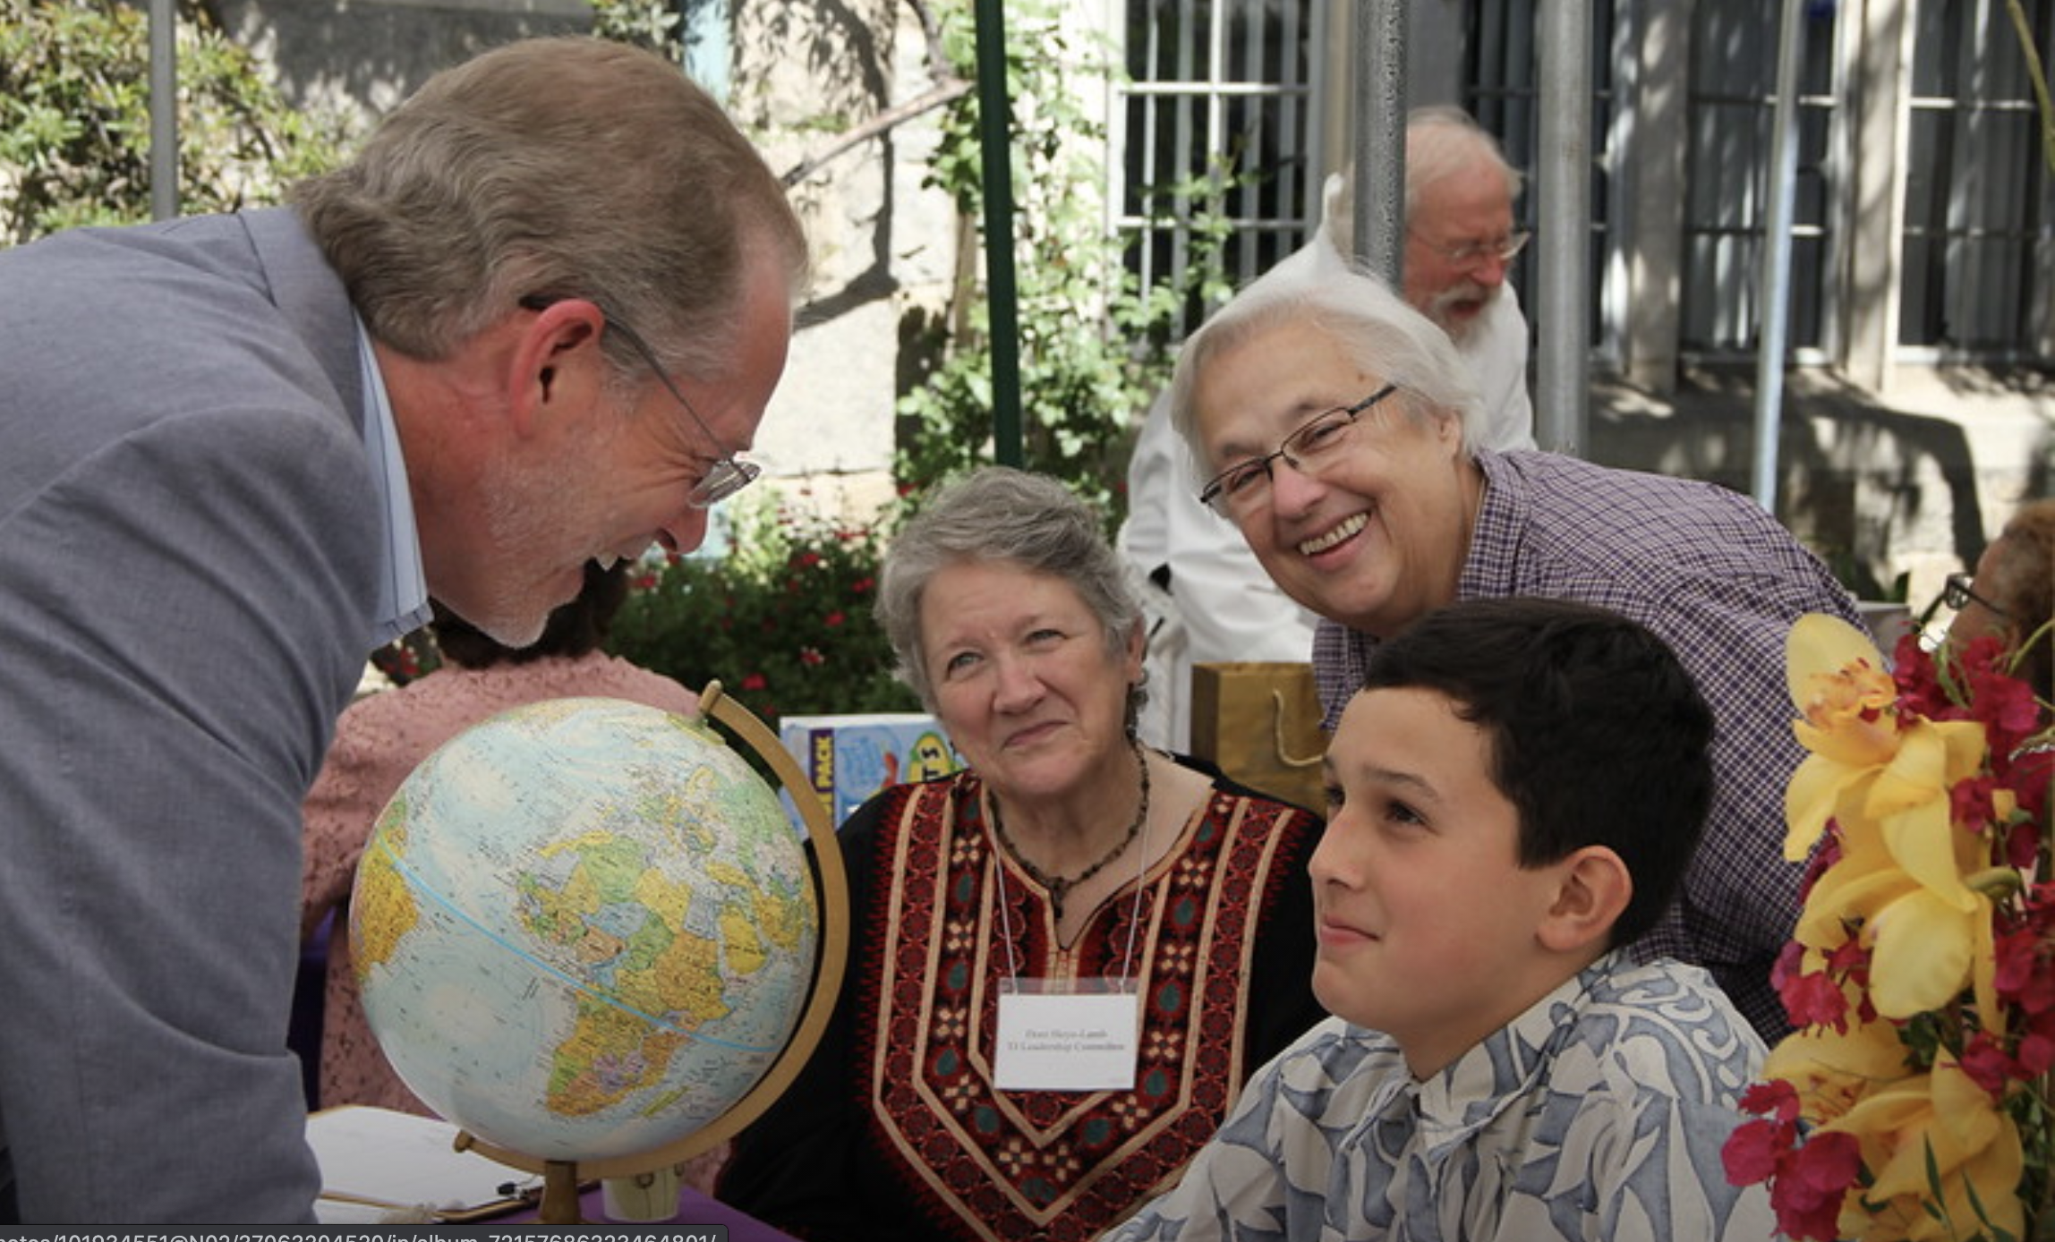
THE CIRCLES – LEARNING & SPIRITUAL GROWTH ACROSS THE LIFESPAN
Fosters a community of learning and spiritual growth from the youngest child to the most senior Saint

Slide 12
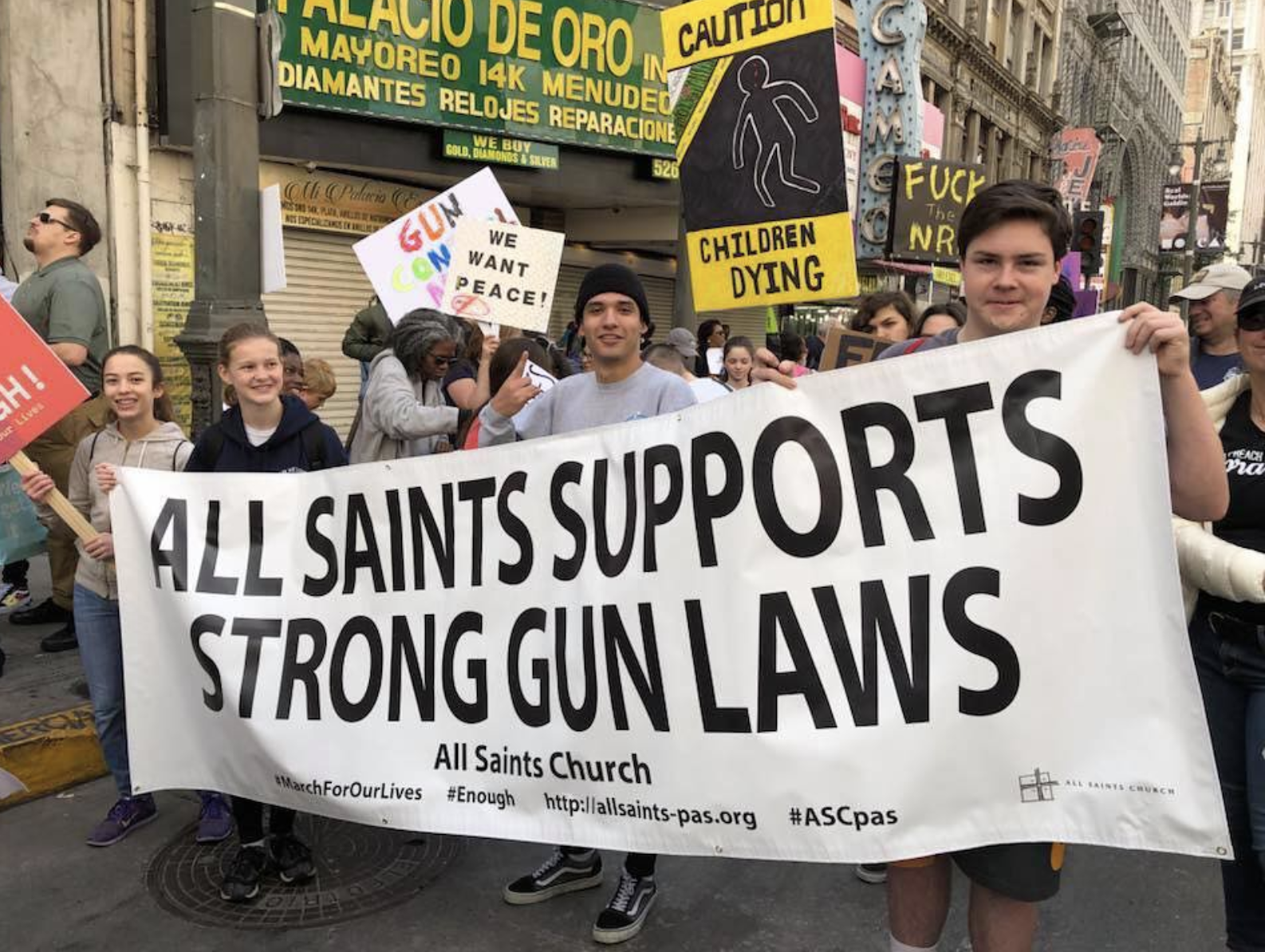
THE CIRCLES – PROGRESSIVE INTENT
INTO ACTION
Takes the theological foundations of Beloved Community and turns us into concrete actors for healing of the world

Slide 13
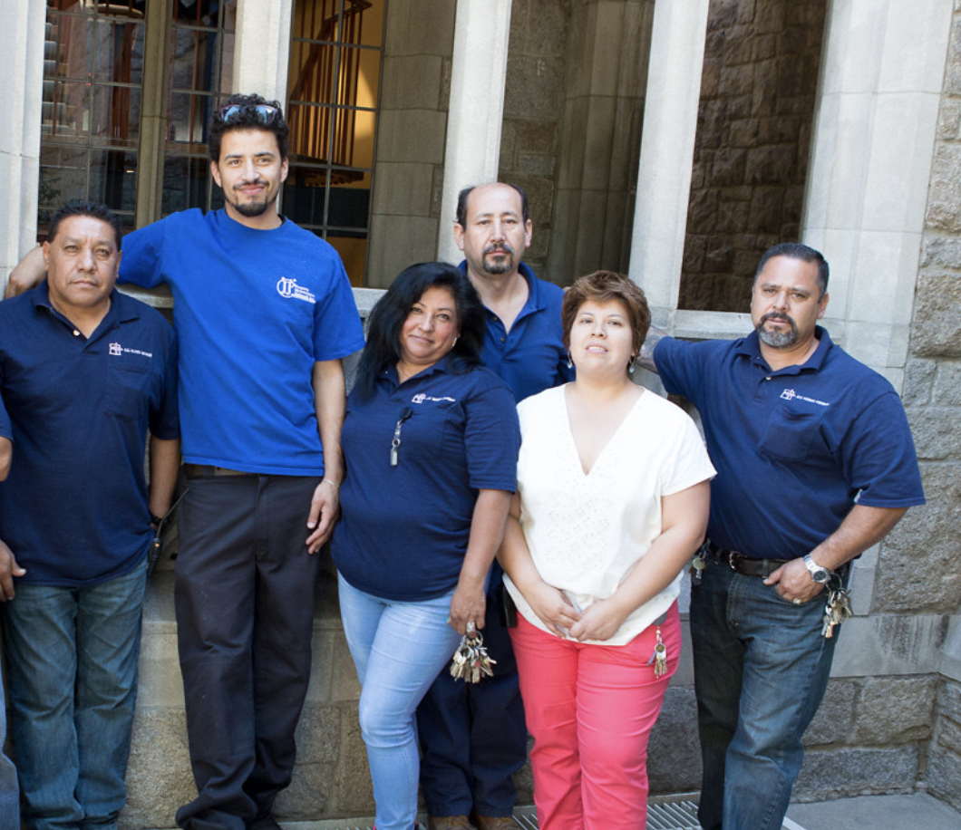
THE CIRCLES – ADMINISTRATION
  The organizational scaffolding that supports the life and work of the community

Slide 14
HOW THE CIRCLES WORK
Each Circle will focus on a key area of the life of All Saints Church – they overlap because the work overlaps
The authority in each Circle is the love of Christ as expressed in our four core values
Different people have different roles in the Circle(s) they are part of… and all are accountable to the values and support one another in living out the values

Slide 15
HOW THE CIRCLES WORK
Each Circle has one or more priests whose community focusing role is the same as it is at Eucharist
Each Circle will design / implement structures that will help everyone support and hold one another accountable in their work. In addition, ASC is contracting with a vendor to implement performance reviews for all staff
Each Circle will decide together on the best structure for the members within the Circle, especially regarding how meetings operate
Notes:
S

Slide 16
HOW THE CIRCLES WORK
Each Circle will include parishioners sharing in the work either on a project-level basis or ongoing basis
The mission of the church is primarily carried out by the people of the church, equipped and empowered by staff
Priests will meet regularly to coordinate the operations of the circles
Rector, Wardens, and Vestry in collaboration with staff set the overall mission direction of the church

Slide 17
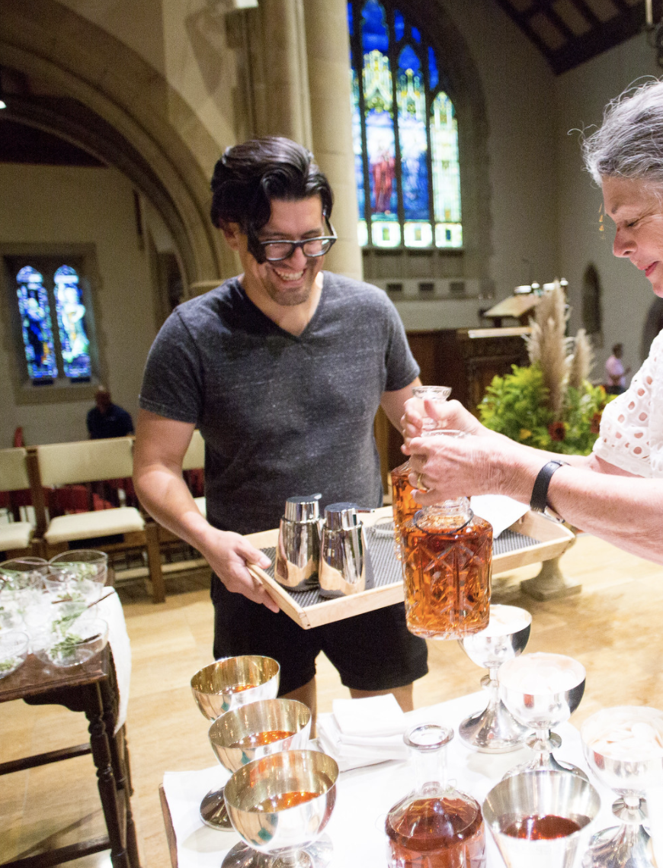
EXAMPLE – LITURGY AND WORSHIP
This Circle will create and chart the evolution of our worship life
Liturgy means “work of the people”
Traditionally, priests determine worship for the congregation
The Circle structure supports priests sharing that responsibility broadly with the community
Priest gathers the people, leads everyone in offering their whole selves to our life of worship, and keeps the work of liturgy focused on the revolutionary Christ
EVERYONE shares in the work of shaping liturgy

Slide 18
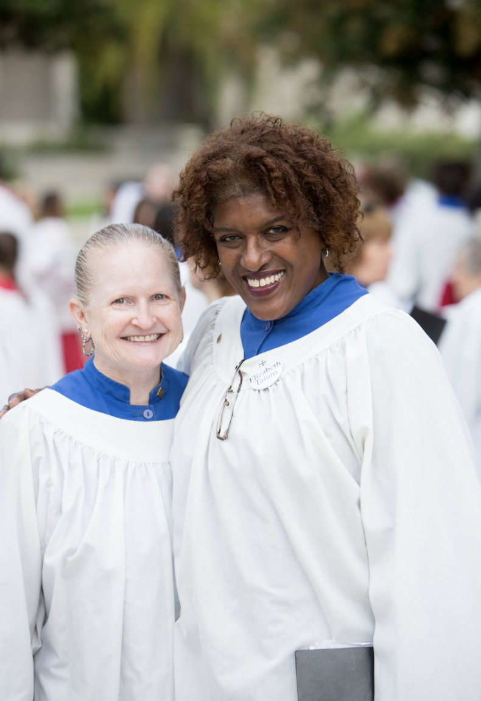
EXAMPLE – LITURGY AND WORSHIP OVERLAPPING WITH OTHER CIRCLES
IMAGINE…
The preaching in worship being coordinated with and supporting themes in faith formation across the congregation for all ages
Music programs being part of our embracing those among us in vulnerable populations in our area
Prayer and Worship opportunities for individuals and families at home and for small groups

Slide 19
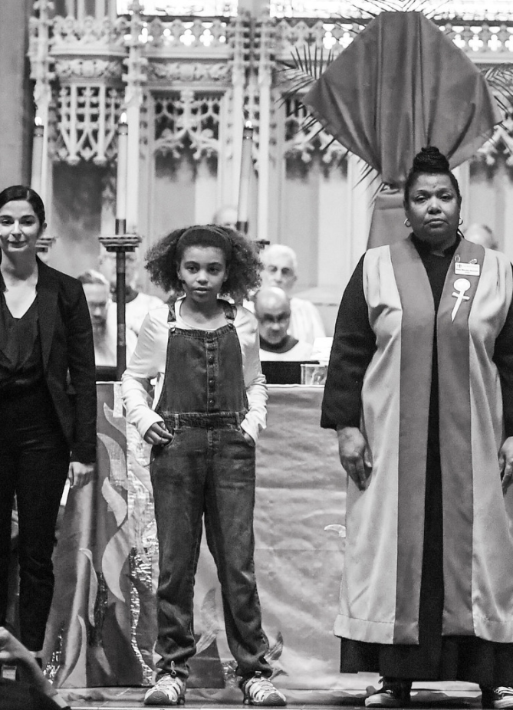
EXAMPLE – LITURGY AND WORSHIP OVERLAPPING WITH OTHER CIRCLES
IMAGINE…
Children and youth not just in traditional roles of acolytes and children/youth choir but actively participating in all aspects of our worship life
A community-wide exploration of how the liturgy of All Saints Church has evolved and where we are being called next

Slide 20
A LEARNING JOURNEY
Successful organizations in the 21st century need to be nimble and agile
We will continuously learn together about how to achieve the best, most creative and collaborative working conditions
What is presented here is an initial structure and we will be adapting it together as we learn

Slide 21
WHAT ARE THE BENEFITS?
Staff is closer to goal-setting and decision making
Parishioners are more integrated into the organizational structure and decision-making
Faster program development and implementation
More efficient organization
  Increased staff empowerment
  Elimination of “silos”
  More decisions made without rector/vestry
Improved employee morale
More responsive to needs of the congregation and opportunities for mission
Notes:
A

Slide 22
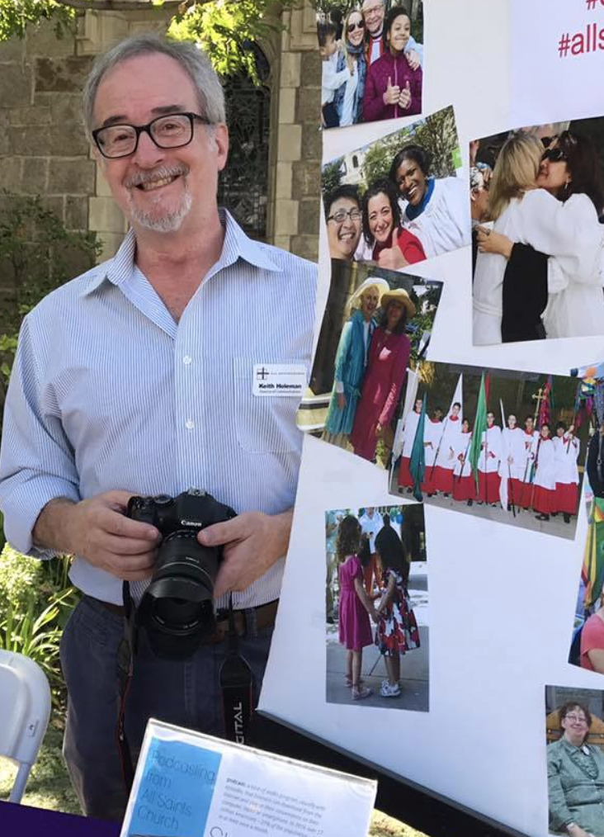
WHO’S IN WHICH CIRCLE?
Staff is going through the process of envisioning and determining the membership of the circles, based on individual interests and organizational need
Many staff members will be in more than one circle – some may be in all circles

Slide 23

WHY DO WE THINK THIS WILL WORK?
There is a growing body of academic research and bottom-line business results that supports these emergent models from psychological, developmental, organizational, and business perspectives
Other organizations are using similar models

Slide 24
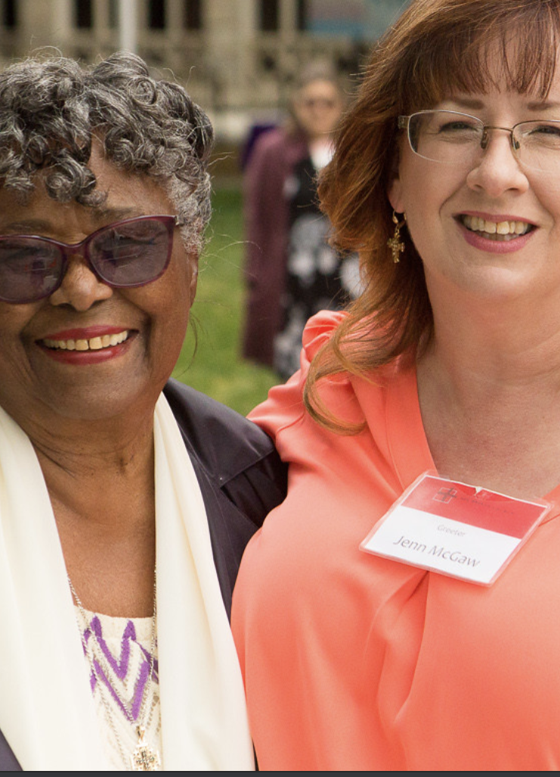
SOME FINAL THOUGHTS
The work of the next 12-18 months will be building a bridge to a much more dynamic All Saints that will carry us through the 21st century
The world around us is changing at an ever-increasing pace, and 2020 has only underscored the need for organizations, including All Saints, to be adaptive
We believe this model will enable All Saints to be an even greater force for good
Please join us on this mission by investing in this transformation with a 2021 pledge

Slide 25

Q & A

