Slide 1
Communications 101
All Saints Church | Fall 2022

Slide 2
Multiplatform Communication
Defined:
“ …utilizing multiple platforms – print, digital, social media, twitter, Facebook, video, etc. – to create an integrated communication strategy.”

Slide 3
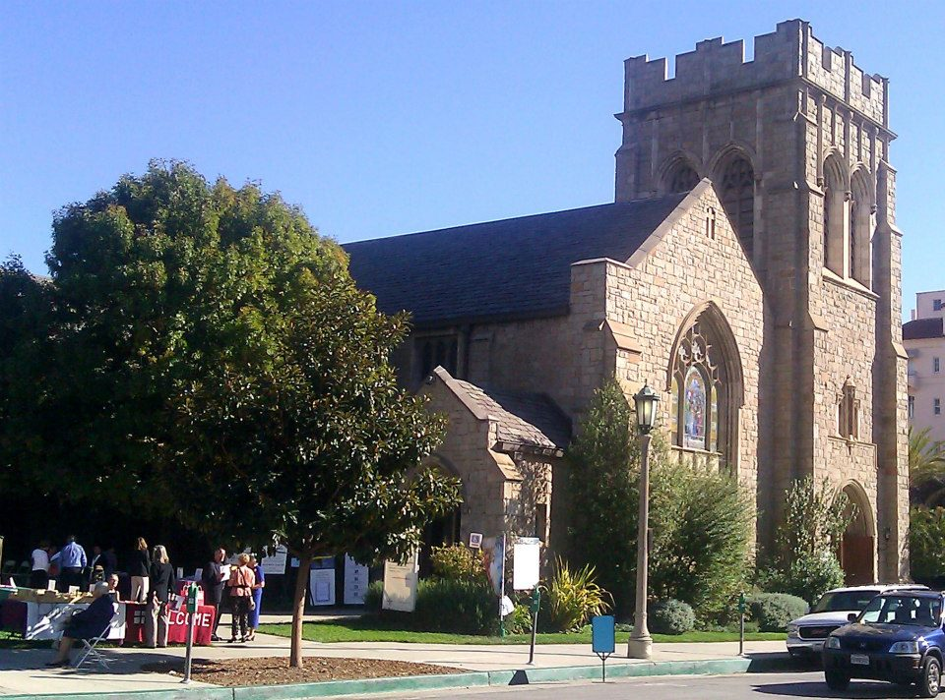
Communicating the work and witness of All Saints Church – within the congregation and to the wider community – has been a key part of our mission for as long as there’s been an All Saints Church.

Slide 4
Multiplatform Communication
That was then …

Slide 5
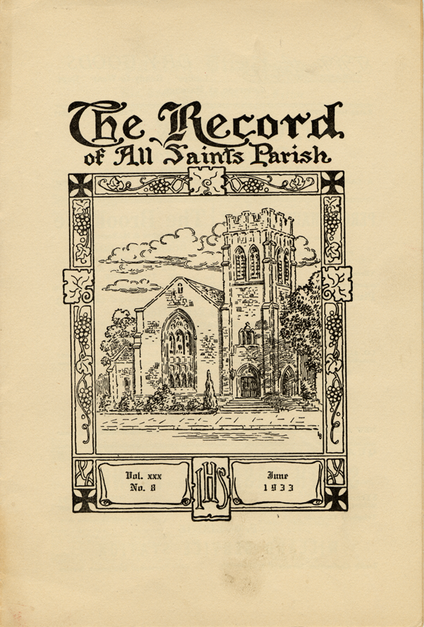
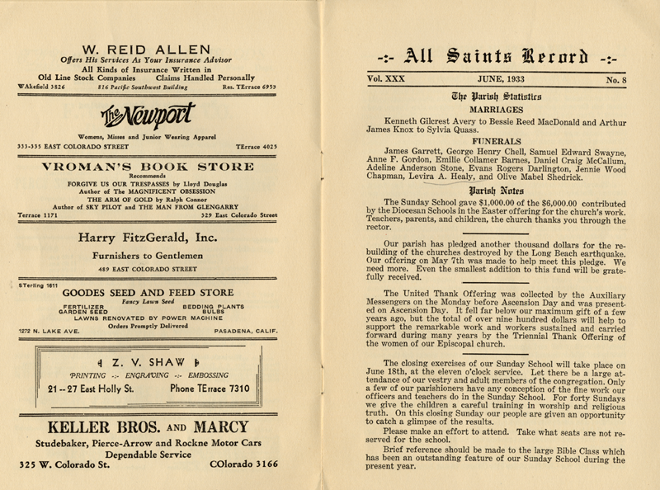
(1933)
“The Record:” monthly parish newsletter.
(Notice the paid ads – including one from Vroman’s.)

Slide 6
All Saints Rector John Scott (1936 – 1957)
His sermons were broadcast over the airwaves on Sunday and were published in the Pasadena Star News on Monday mornings.

Slide 7
In the 1950’s volunteers literally ironed the creases in the bulletins before sending them off to the post office for mailing.

Slide 8
In the 1970’s All Saints launched a “tape ministry” and countless cassette tapes were sent out over the years of sermons delivered from the ASC pulpit.

Slide 9
And in the late-1990’s we entered the digital age with our first website – captured here from The Wayback Machine
(Notice the Sunday Action was about Impeachment vs Censure.)

Slide 10
Multiplatform Communication
This is now…

Slide 11
All Saints Rector Mike Kinman
His sermons are live-streamed, podcast, and “YouTubed”
He tweets, he blogs, he “Facebook Lives” and yes … he knows how to work a crowd

Slide 12
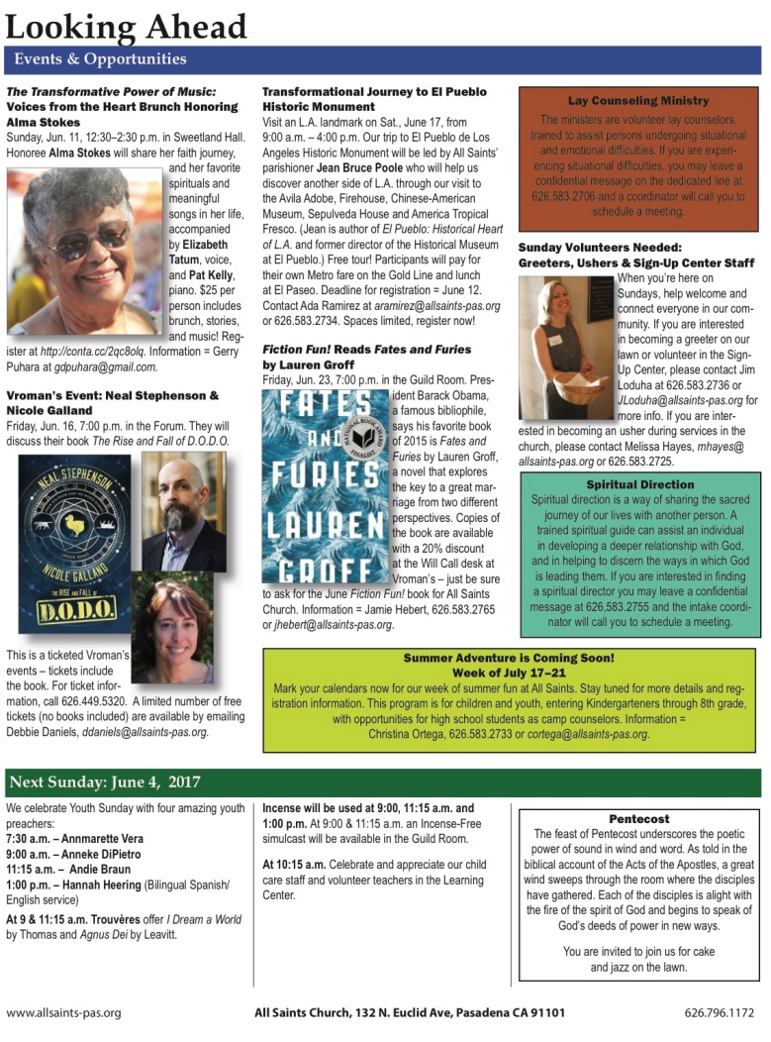
This Week at All Saints (TWAAS)
Weekly newsletter:
Sent via email and attached to the service leaflet on Sunday
Focus on upcoming events, programs, calendar items

Slide 13
email
“ASC Weekly” (Thursday)
Other occasional email blasts (staff changes; breaking news)

Slide 14
allsaints-pas.org
Website
The All Saints website is the online “encyclopedia” of everything All Saints.
Whoever you are, and wherever you find yourself looking for information about All Saints Church you’ll find it at:

Slide 15
When we updated the site our wish list included easy to navigate on a variety of devices with both static data and breaking news content combined on one image driven platform.
(Our data told us 44% of our website access was via tablet or smart phone and the old site was optimized for neither.)
We wanted a site that would highlight timely information, automatically publish all posts to Facebook and Twitter and one that was optimized for desktop, smart phone and tablet.
We wanted content that was both easy to read and easy to update — and sermon posts that included both video and text.
And we wanted it all to fit in a non-profit budget.

Slide 16
Live Streaming
We currently live stream the Sunday Forum and the 10:00 a.m. service every week -- in addition to special events and programs throughout the year.
Our growing online community is an important part of taking the work and witness off All Saints Church beyond our walls and into the world.
On Easter Sunday our streaming stats included 450 unique viewers from UK, Germany, Brazil, Puerto Rico, Mexico, Slovakia, Spain, Russia, Costa Rica and 31 states + D.C.

Slide 17
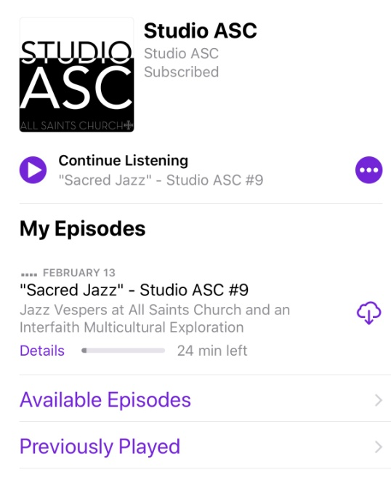
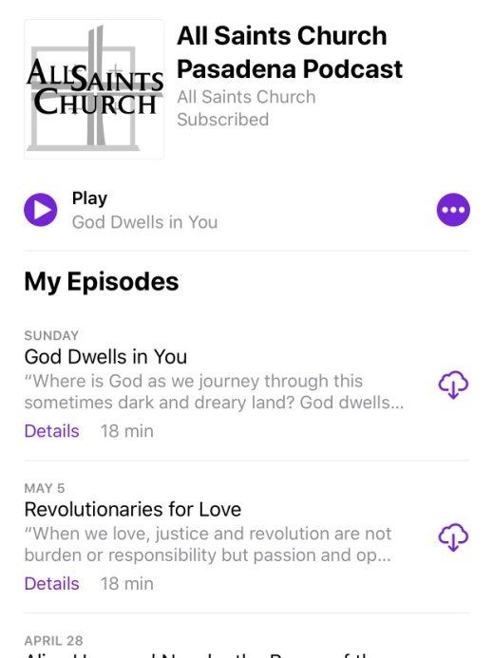
Podcasts
Studio ASC: An archived magazine format podcast series with guest interviews and reflections.
iTunes: Where Sunday sermons are posted weekly.
Subscribe wherever you get your podcasts or access through the website.

Slide 18
Social Media: Whoever you are and wherever you find yourself …

Slide 19
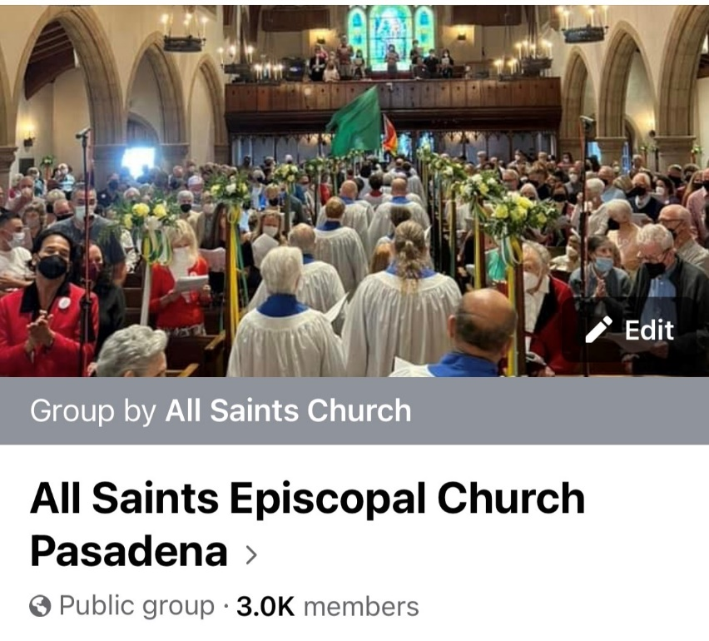
Facebook
Facebook is “aimed at friends of ASC, the ones who want to sit in our living room and look through our scrapbooks.”
-- Rick Bolton
Facebook Page: Communication from organization to members
Facebook Group: Community building between members

Slide 20
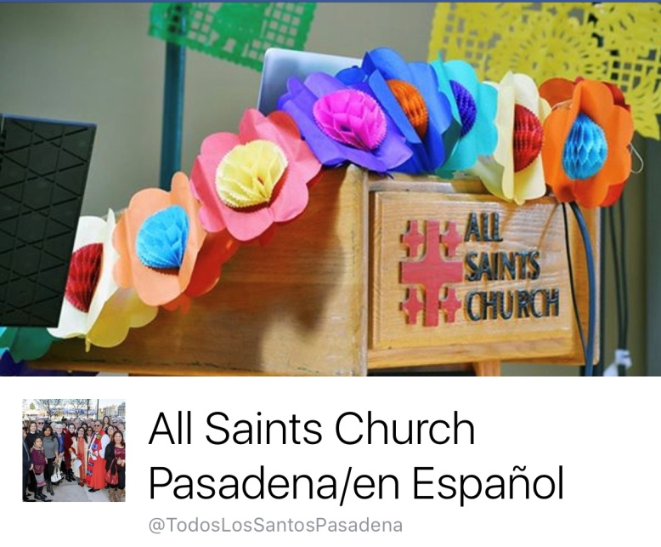
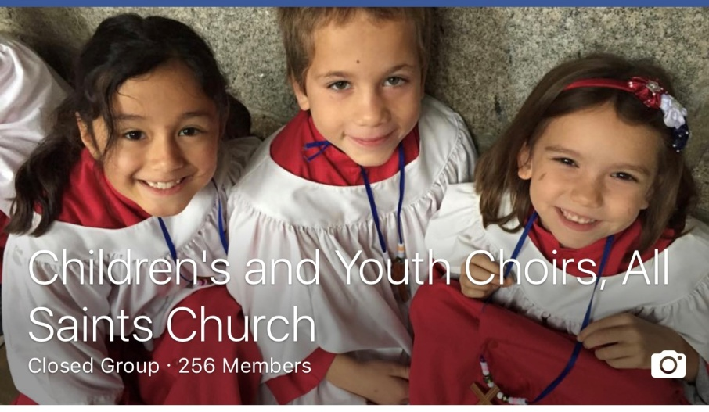
Facebook
ASC also has Facebook groups and pages for affinity and interest groups … some public and some closed.

Slide 21
twitter
Twitter is a "call to action." A tweet is fast, to the point, broadcast widely to anyone who cares to listen.

Slide 22
Instagram
Image driven platform that tells the All Saints story one photo at a time

Slide 23
YouTube
Archive of sermons, Forums and other presentations from All Saints 1000+ videos. Over 16,000 subscribers. Over 3M total views.

Slide 24
The Welcome Center
Multiplatform communication includes incarnational communication: one on one conversations between members of the ASC community in real time.

Slide 25
Banners on the Lawn
Another way to put our faith into action …

Slide 26
Multiplatform Communication
Deployed:
“ …utilizing multiple platforms – print, digital, social media, twitter, Facebook, video, etc. – to create an integrated communication strategy …” … all in the service of:

